Slide 1
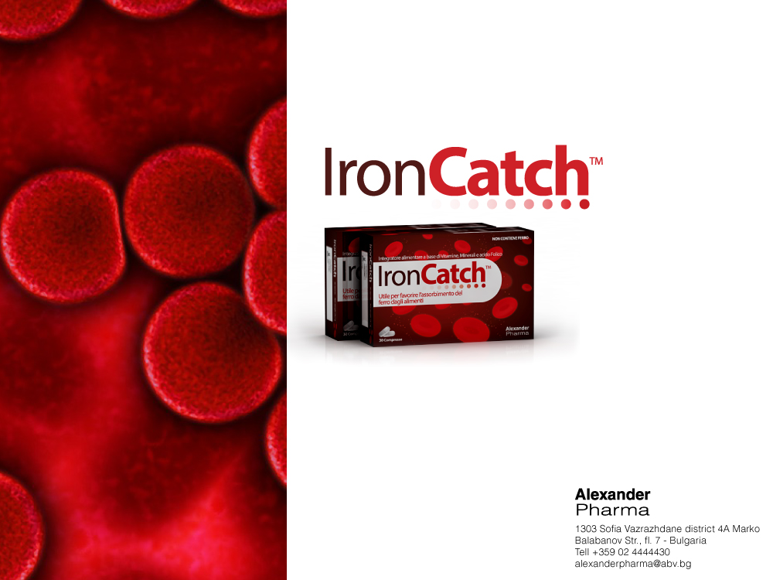
Overview –clinical studies

Slide 2
Clinical Experience with IronCatch
Two studies were carried out in Italy
1st: University of Pavia
2nd: University of Bologna

Slide 3
1st Study:
University of Pavia

Slide 4

University Of Pavia, Italy Endocrine-Nutritional Service
Effect of treatment with a food supplement (containing: selected sea fish cartilage, vitamin C, vitamin E, folic acid, zinc, copper) in women with iron deficiency: double blind, randomized, placebo- controlled trial

Slide 5
Rondanelli M et al; Cont…..
49 fertile iron deficient female patients, with blood iron values <60mg/dl or blood ferritin values <20ng/ml, were randomly assigned to Captafer or Placebo
+60% in ferritin from the 1st month vs placebo
+80% in syderemia from the 1st month vs placebo
Notes:
Aim: The use of food supplement containing nutrients useful for improving the bioavailability of Fe and that is well tolerated can represent a valid alternative to iron therapy.
Patients: 49 fertile women with ID underwent 3 assessments: basal, after 30 days, and after 60 days.
They were randomly assigned to Captafer or Placebo.
The patients were then subdivided into 2 groups according to the basal blood iron (<60ug/dL) or blood ferritin (<20 ng/mL) values.

Slide 6

Pavia Study
+55%
70
60
Subjects with a sideremia level <60
50
40
SIDEREMIA mg/dl
30
FERRITINEMIA ng/ml
20
10
0
t0
1 month
2 months

Slide 7

Pavia Study
80
70
Subjects with a ferritin level <20
60
50
40
SIDEREMIA mg/dl
30
FERRITINEMIA ng/ml
20
+50%
10
+50%
0
to
1 month
2 months

Slide 8
2nd Study:
University of Bologna

Slide 9

University Of Bologna, Italy St. Orsola Hospital
Published on
"World Journal of Gastroenterology"

Slide 10
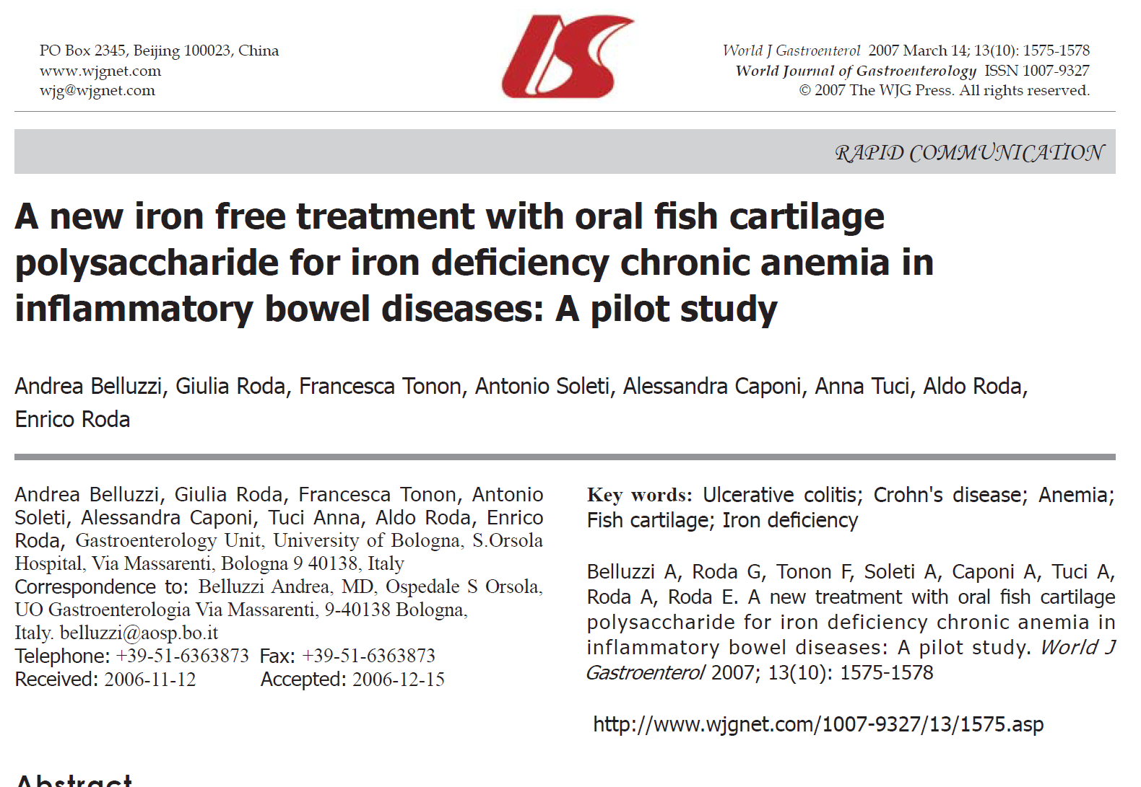

Slide 11
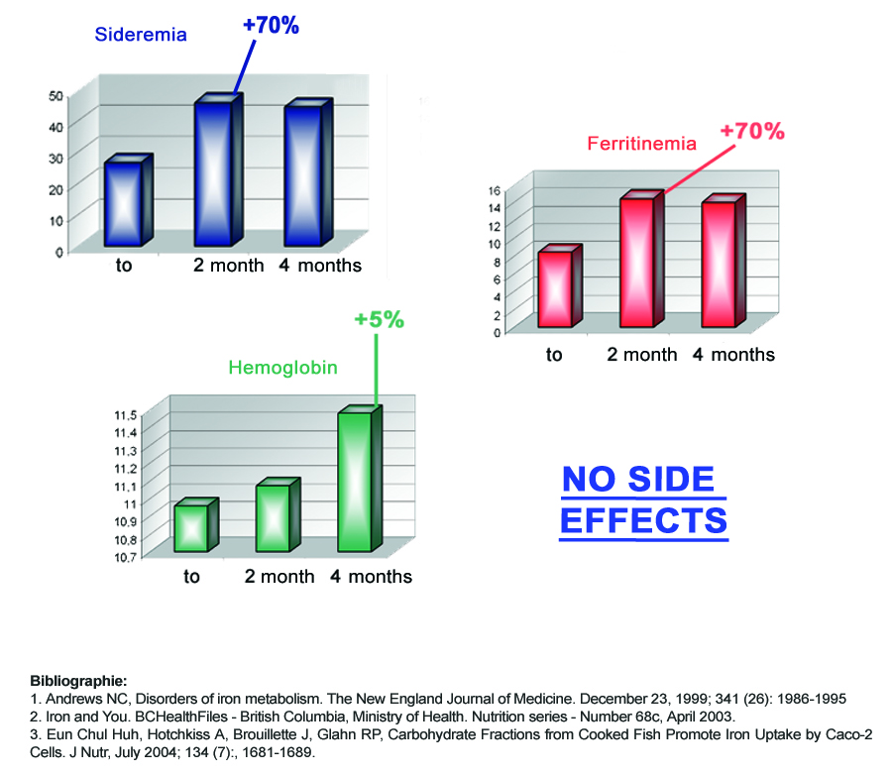

Slide 12




Bologna Study
+70%
Sideremia (ug/dL)
50
40
30
20
10
0
to
2 months
4 months

Slide 13



Bologna Study
+70%
Ferritinemia (ng/ml)
16
14
12
10
8
6
4
2
0
to
2 months
4 months

Slide 14



Bologna Study
+5%
Hemoglobin (g/dL)
11,5
11,4
11,3
11,2
11,1
11
10,9
10,8
10,7
to
2 months
4 months

